Slide 1
HE CALLED MY NAME…!

Slide 2
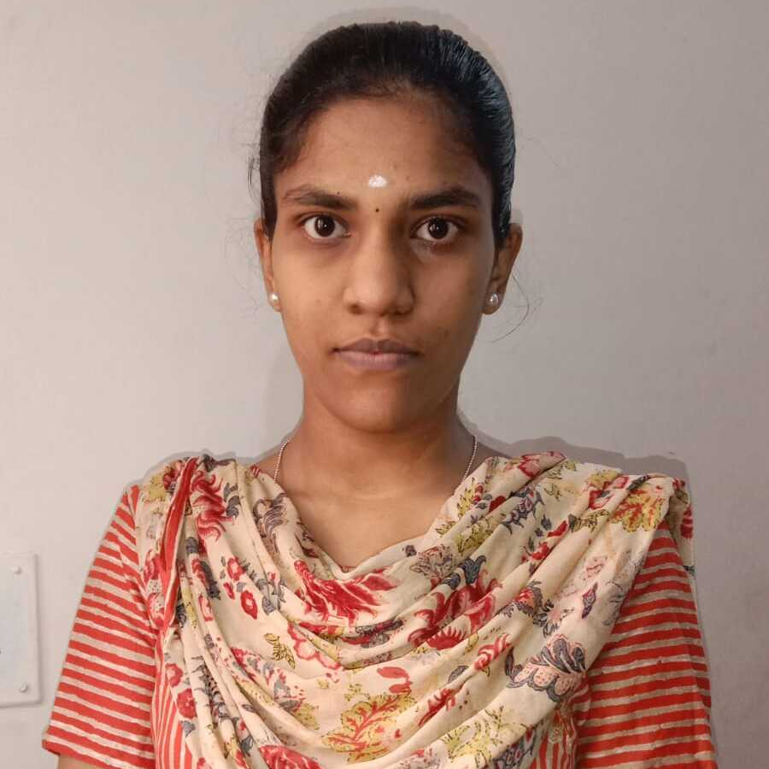
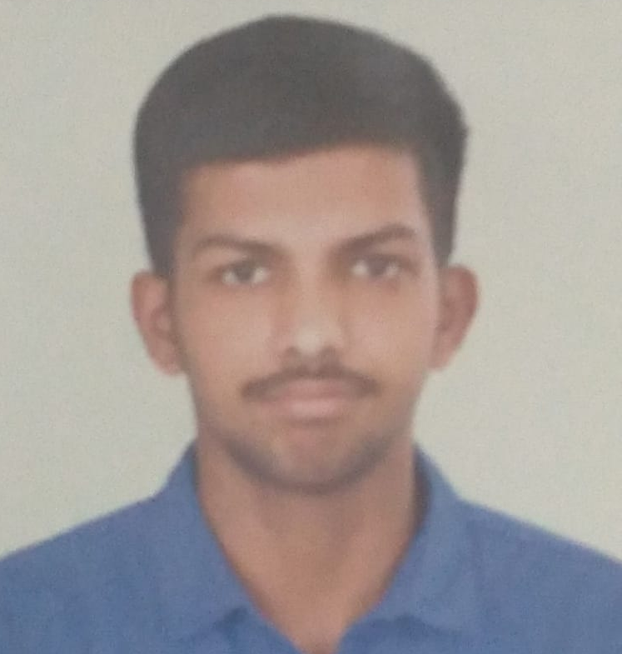
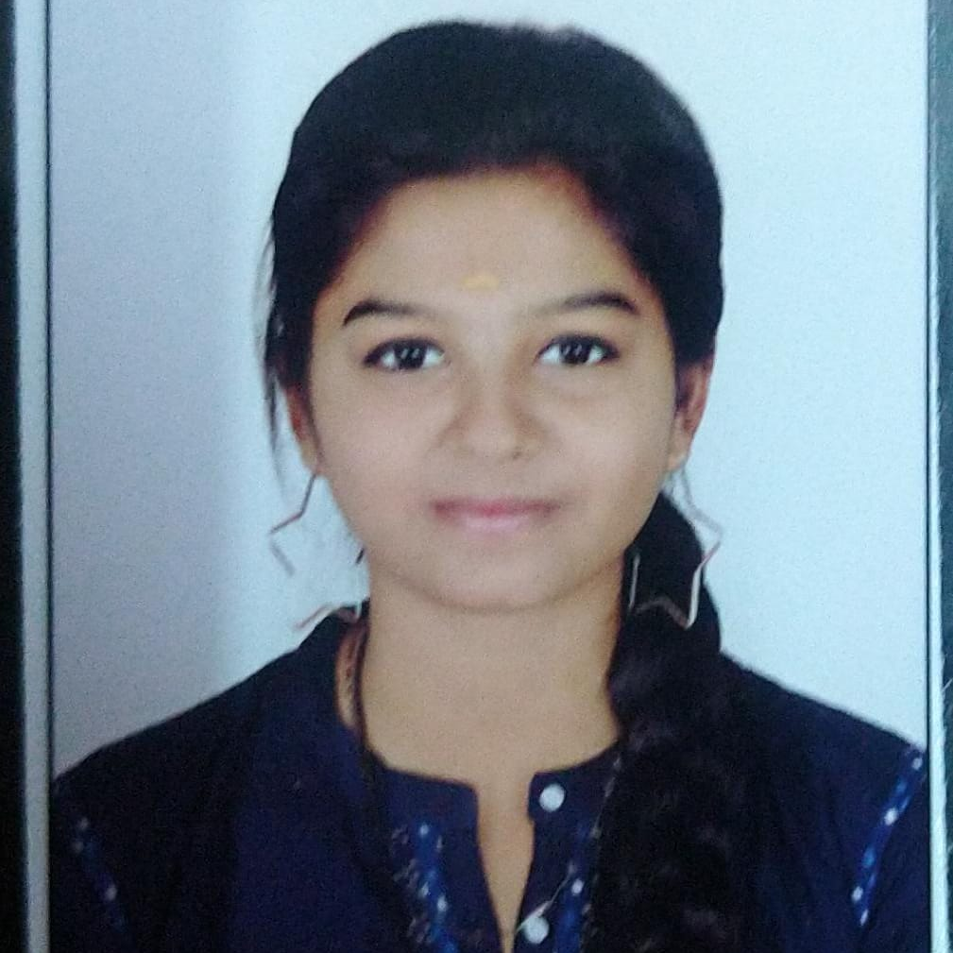
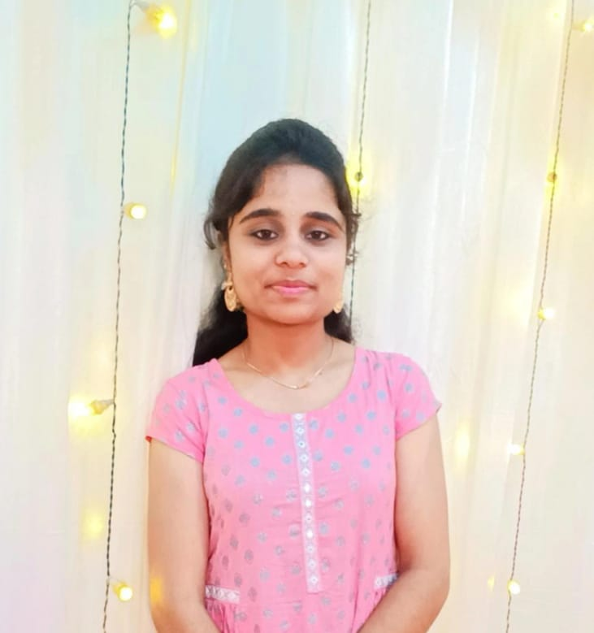
Team Slide
Akshaya Keerthi J
Sai Esvar
Thirisha J
Santhiya R
akshayajkumar2003@gmail.com
saiesvar42206@gmail.com
thirishaj003@gmail.com
santhiyaramesh16@gamil.com
Notes:
Please replace photograph with your team member by right click on image > change picture
Please add role and company name and add your email ID.
Feel free to remove extra picture and details if team size is smaller

Slide 3
Problem Statement & Proposed Solution
Problem
Solution
Huge traction worldwide owing to its contactless biometric features. Companies are getting rid of traditional fingerprinting scanners due to the time consumption during crowded hours. The main problem is its high dimension space, which is to be reduced by any dimension reduction techniques.
The pattern recognition approach tries to match the facial features, which are extracted from all the images present in the database. Therefore, there are two major problems one is feature extraction and then pattern recognition. Before this image, registration of all the faces is required to enhance the recognition rate of the whole system. So these all motivates to search for a new method to solve all these problems and then integrate them to make a fully functional system with high accuracy.If the faces are new it gives alert to the security.
Notes:
Problem: Please briefly mention what is the problem you are trying to solve / what is problem statement Solution: What approach you took to solve the problem/ what is the solution / your solution to the problem

Slide 4
Benefits & Technologies Used
Details
Benefits
End-User | Peoples
User Department | Reception and Security Departments
Industries | All type of Industries
UiPath Products Used | Studio, G Suite, Document Understanding, Apps
Other – Integrations / APIs / Technologies Used | Python, Face SDK, Artificial Intelligence
Face Recognition is easy to use and in many cases it can be performed without a person even knowing.
Identify victims of crime.
Face Recognition is also one of the most inexpensive biometric in market.
Protect bank account holders against ATM fraud.
Time Management
Less Manpower
Notes:
Details: Its always good to share details like who is the end-user of your solution, which department/industry will benefit and what technologies have been used.
Benefits: Please include key features / value proposition of your solution

Slide 5
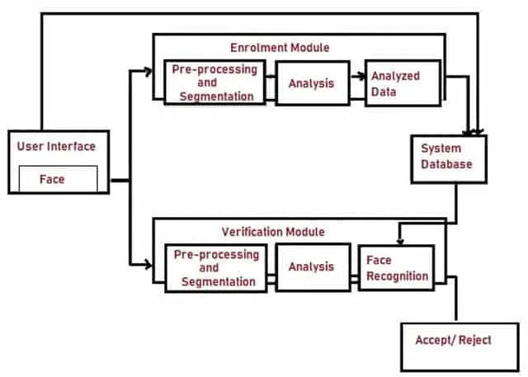


Solution Architecture
Hello, Mr.Harry.
Notes:
You can remove the slide if you are not showing Solution Architecture

Slide 6

Thank You :)

